Slide 1
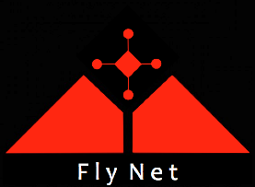

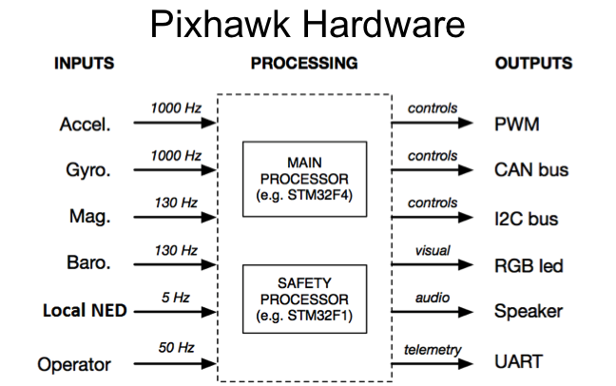
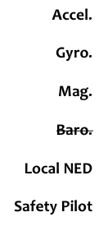
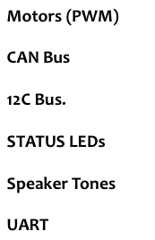
Pixhawk Functionality

Slide 2
Pixhawk – Off-board Computer Interface
FlyNet: Autonomous Quadcopter Search and Rescue
Embedded Controller (Pixhawk)
Linux Companion Computer
Actuator & Sensor Interface
Safety Controller
SLAM
Obstacle Avoidance
uORB publish/subcribe bus
ROS publish/subscribe bus
UART MAVlink
>250 Hz
< 1 ms latency
Local NED Subscriber
Planner Generated Set point
Local NED Publisher
Path
Planner
Position Controller
Custom
Modified
Attitude Controller
Preexisting

